Slide 1

Unit 04.02.01 CS 5220: COMPUTER COMMUNICATIONS
Classless Interdomain Routing (CIDR)
XIAOBO ZHOU, Ph.D.
Professor, Department of Computer Science

Slide 2
IP Address Problems
IP Address Exhaustion
Class A, B, and C address structure inefficient
Class B too large for most organizations, but future proof
Class C too small
IP routing table size
Growth in # of networks in Internet reflected in # of table entries
Stress on router processing power and memory allocation
Short-term solution:
Classless Interdomain Routing (CIDR), RFC 1518
New allocation policy (RFC 2050)
Private IP Addresses set aside for intranets (NAT)
Long-term: IPv6 with much bigger address space

Slide 3
Classless Interdomain Routing Scheme
CIDR uses an arbitrary prefix length to indicate the network number
205.100.0.0/22
/22 means mask: 11111111 11111111 11111100 00000000
255.255.252.0
Packets are routed according to the prefix w/o address classes
An entry in CIDR routing table contains 32-bit IP address and 32-bit mask
Enables supernetting to allow a single routing entry to cover a block of classful addresses

Slide 4
CIDR Aggregation
A company is allocated the following four contiguous /24 networks. At some router, it is often true that all of the four networks use the same outgoing line. CIDR aggregation can be done to reduce the number of entry at the router.
128.56.24.0/24; 10000000 00111000 00011000 00000000
128.56.25.0/24; 10000000 00111000 00011001 00000000
128.56.26.0/24; 10000000 00111000 00011010 00000000
128.56.27.0/24. 10000000 00111000 00011011 00000000
By Per-bit AND
128.56.24.0/22 10000000 00111000 00011000 00000000
(Instead of 4 entries in routing table, one entry is sufficient by CIDR)

Slide 5
CIDR Scheme and Range
CIDR deals with Routing Table Explosion Problem
Networks represented by prefix and mask
Summarize a contiguous group of class C addresses using variable-length mask, if all of them use the same outgoing line
Solution: Route according to prefix of address, not class
Routing table entry has <IP address, network mask>
Example: 192.32.136.0/21
11000000 00100000 10001000 00000001 min address
11111111 11111111 11111--- -------- mask
11000000 00100000 10001--- -------- IP prefix
11000000 00100000 10001111 11111110 max address
Eight C networks: 192.32.136.0/24 to 192.32.143.0/24

Slide 6
CIDR Supernetting Example (1)
Summarize a contiguous group of class C addresses using variable-length mask
Example: 150.158.16.0/20
IP Address (150.158.16.0) & mask length (20)
IP address = 10010110 10011110 00010000 00000000
Mask = 11111111 11111111 11110000 00000000
Contains 16 Class C blocks:
From 10010110 10011110 00010000 00000000
i.e. 150.158.16.0/24
Up to 10010110 10011110 00011111 00000000
i.e. 150.158.31.0/24

Slide 7
CIDR Supernetting Example (2)
A router has the following CIDR entries in its routing table:
Address/mask Next hop
128.56.24.0/22 Interface 0
128.56.60.0/22 Interface 1
default Router 2
A packet comes with IP address of 128.56.63.10. What does the router do?

Slide 8
CIDR Supernetting Example (2) – Cont.
128.56.63.10 and mask 22 bits
IP address = 10000000 00111000 01111111 00001010
Mask = 11111111 11111111 11111100 00000000
By Per-bit AND
Prefix = 10000000 00111000 01111100 00001010
i.e. 128.56.60
Router table lookup and match, should go to interface 1

Slide 9
New Address Allocation Policy
Class A & B assigned only for clearly demonstrated need
Consecutive blocks of class C assigned (up to 64 blocks)
All IP addresses in the range have a common prefix, and every address with that prefix is within the range
Arbitrary prefix length for network ID improves efficiency
Address assignment should reflect the physical topology of the network
Facilitates the aggregation of logical packet flows into physical flows
Address Requirement | Address Allocation
< 256 | 1 Class C
256<,<512 | 2 Class C
512<,<1024 | 4 Class C
1024<,<2048 | 8 Class C
2048<,<4096 | 16 Class C
4096<,<8192 | 32 Class C
8192<,<16384 | 64 Class C

Slide 10
Longest Prefix Match
By CIDR, multiple entries may match a given IP destination address but different prefix
Example: perform CIDR on the following three /24 IP addresses (but 128.56.24.0/24 to a different port)
128.56.25.0/24;
128.56.26.0/24;
128.56.27.0/24;
By CIDR aggregation: 128.56.24.0/22
What if a packet with destination IP address 128.56.24.1 comes?

Slide 11
Example of Longest Prefix Match
Packet coming with
Address 128.56.24.1
Company A
128.56.25.0/24
128.56.26.0/24
128.56.27.0/24
Company B
128.56.24.0/24
R
Port 1
Port 0
Routing Table at R
Address/mask Next Hop
128.56.24.0/24 0
128.56.24.0/22 1
Longest Prefix Match: packet must be routed using the more specific route (128.56.24.0/24)

Slide 12
Unit 04.02.02 CS 5220: COMPUTER COMMUNICATIONS
ARP, Fragmentation and Reassembly
XIAOBO ZHOU, Ph.D.
Professor, Department of Computer Science

Slide 13
Address Resolution Protocol
IP addresses are said to be logical, because they are defined in terms of logical topology of the routers and end systems.
The logical IP addresses need to be converted into specific physical addresses that identify the physical endpoints for the Ethernet sender and receiver
ARP: conversion between IP address and Physical address

Slide 14
Address Resolution Protocol (ARP)
How to map an IP address to a physical address? How to speed up? How fresh?
H1 wants to learn physical address of H3 -> broadcasts an ARP request
H1
H2
H3
H4
150.100.76.20
150.100.76.21
150.100.76.22
150.100.76.23
ARP request (what is the MAC address of 150.100.76.22?)
Every host receives the request, but only H3 reply with its physical address
H1
H2
H3
H4
ARP response (my MAC address is 08:00:5a:3b:94)

Slide 15
Fragmentation and Reassembly
Each physical network imposes a certain packet size limitation on the packet to be carried, called maximum transmission unit MTU.
Q1: who does it?
Reassemble
at destination
Q2: penalty?
Source
Router
Destination
Fragment
at source
Fragment
at router
IP
IP
Network
Network

Slide 16
RE: IP Packet Header
0 4 8 16 19 24 31
Version IHL Type of Service Total Length
Identification Flags Fragment Offset
Time to Live Protocol Header Checksum
Source IP Address
Destination IP Address
Options Padding
Identification, Flags, and Fragment Offset: used for fragmentation and reassembly
Fragment offset is 13 bits; total length is 16 bits, what does it imply?

Slide 17
Example: Fragmenting a Packet
Packet is to be forwarded to a network with MTU of 576 bytes. The packet has an IP header of 20 bytes and a data part of 1484 bytes.
Maximum data length per fragment = 576 - 20 = 556 bytes.
Set maximum data length to 552 bytes to get multiple of 8.
 | Total Length | Id | MF | Fragment Offset
Original packet | 1504 | x | 0 | 0
Fragment 1 | 572 | x | 1 | 0
Fragment 2 | 572 | x | 1 | 69
Fragment 3 | 400 | x | 0 | 138

Slide 18
Unit 04.02.03 CS 5220: COMPUTER COMMUNICATIONS
DHCP, NAT
XIAOBO ZHOU, Ph.D.
Professor, Department of Computer Science

Slide 19
DHCP
Dynamic Host Configuration Protocol (RFC 2131)
Bootstrap Protocol BOOTP allows a diskless workstation to be remotely booted up in a network
UDP port 67 (server) & port 68 (client)
DHCP builds on BOOTP to allow servers to deliver configuration information to a host
Used extensively to assign temporary IP addresses to hosts
Allows ISP to maximize usage of their limited IP addresses
Time thresholds to enforce lease time

Slide 20
Network Address Translation (NAT)
Class A, B, and C addresses have been set aside for use within private Internets
Private IP addresses are sufficient for use inside of private networks
But packets with private (“unregistered”) addresses are discarded by routers in the global Internet
NAT (RFC 1631): method for mapping packets from hosts in private internets into packets that can traverse the Internet
A device (computer, router, firewall) acts as an agent between a private network and a public network
A number of hosts can share a limited number of registered IP addresses

Slide 21
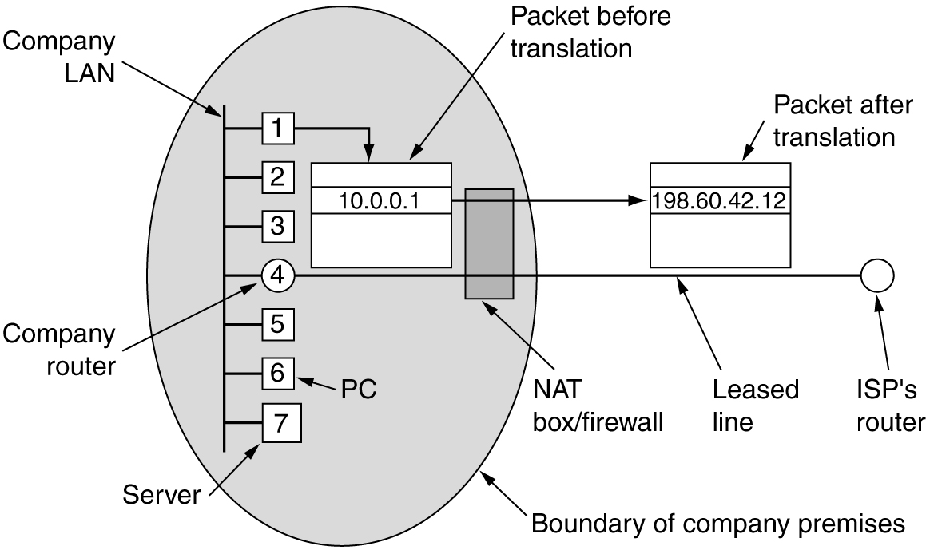
Placement of Operation of a NAT Box
NAT: provides mapping between public IP address and private IP addresses

Slide 22

NAT Operations
Address Translation Table: 192.168.0.10; x 128.100.10.15; y
192.168.0.13; w 128.100.10.15; z
192.168.0.10;x
128.100.10.15;y
Private Network
NAT Device
Public Network
192.168.0.13;w
128.100.10.15; z
Hosts inside private networks generate packets with private IP address & TCP/UDP port #s
NAT maps each private IP address & port # into shared global IP address & available port #
Translation table allows packets to be routed unambiguously

Slide 23
NAT Discussions
In theory, up to 2^16 private IP addresses supported by a single public IP address in NAT box
Overhead in NAT operation
TCP/UDP Port number used for NAT mapping at IP layer, violating OSI layer architecture principle

Slide 24
Unit 04.02.04 CS 5220: COMPUTER COMMUNICATIONS
IPv6
XIAOBO ZHOU, Ph.D.
Professor, Department of Computer Science

Slide 25
IPv6
Longer address field:
128 bits can support up to 3.4 x 10³⁸ hosts
Simplified header format:
Simpler format to speed up processing of each packet header
All fields are of fixed size

Slide 26
IPv4 vs IPv6 Overview
IPv4 vs IPv6 fields:
Same: Version
Dropped: Header length, ID/flags/frag offset, header checksum
Replaced:
Datagram length by Payload length
Protocol type by Next header
TTL by Hop limit
TOS by traffic class
New: Flow label

Slide 27
IPv6 Header Format
0 4 12 16 24 31
Version Traffic Class
Flow Label
Payload Length Next Header Hop Limit
Source Address
Destination Address
Version field same size, same location
Traffic class to support differentiated services
Flow: sequence of packets from particular source to particular destination for which source requires special handling

Slide 28
IPv6 Basic Header Format
0 4 12 16 24 31
Version Traffic Class
Flow Label
Payload Length Next Header Hop Limit
Source Address
Destination Address
Payload length: length of data excluding header, up to 65535 B
Next header: type of extension header that follows basic header
Hop limit: # hops packet can travel before being dropped by a router

Slide 29
Extension Headers
Allows an arbitrary number of extension headers be placed between the basic header and the payload (the extension headers are chained by the next header field)
Large Packet (Jumbo packet): payload>64K
0 8 16 24 31
Next header 0
194
Opt len = 4
Jumbo payload length

Slide 30
Extension Headers
Fragmentation: At source only
Source performs “path MTU discovery” (a fragment extension header for each packet fragment)
0 8 16 29 31
Next header Reserved Fragment offset Res M
Identification

Slide 31
Extension Headers
Source Routing: strict/loose routes
0 8 16 24 31
Next header Header length Routing type = 0 Segment left
Reserved Strict/loose bit mask
Address 1
Address 2
. . .
Address 24

Slide 32
IPv6 Addressing
Address Categories
Unicast: single network interface
Multicast: group of network interfaces, typically at different locations. Packet sent to all.
Anycast: group of network interfaces. Packet sent to only one interface in group, e.g. nearest.
Hexadecimal notation
Groups of 16 bits represented by 4 hex digits
Separated by colons
4BF5:AA12:0216:FEBC:BA5F:039A:BE9A:2176
Shortened forms:
4BF5:0000:0000:0000:BA5F:039A:000A:2176
To 4BF5:0:0:0:BA5F:39A:A:2176
To 4BF5::BA5F:39A:A:2176
Mixed notation:
::FFFF:128.155.12.198

Slide 33
Migration from IPv4 to IPv6
Gradual transition from IPv4 to IPv6
Dual IP stacks: routers run IPv4 & IPv6
Type field used to direct packet to IP version
IPv6 islands can tunnel across IPv4 networks
Encapsulate user packet insider IPv4 packet
Source
Tunnel head-end
Tunnel tail-end
Destination
Tunnel
IPv6 header
IPv6 network
IPv4 header
IPv6 network
IPv4 network

